Slide 1
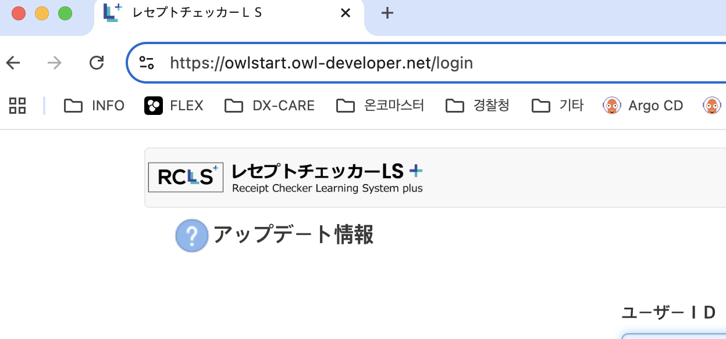
1. Login

Slide 2
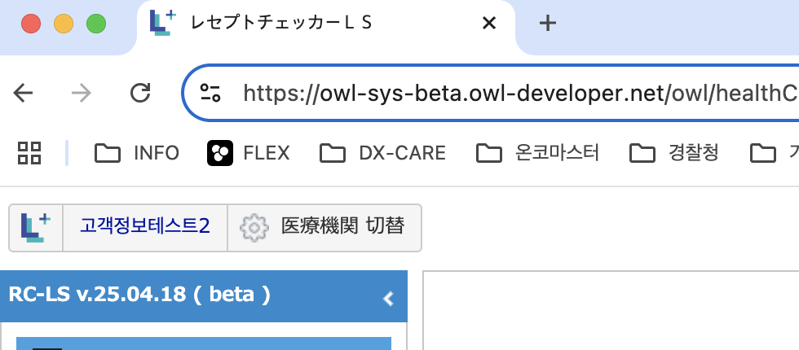
2. RC-LS System

Slide 3
3. Information

